Slide 1

Understanding Linux Operating System
By Sulav Adhikari

Slide 2
Introduction to Linux
Linux is a free, open-source, Unix-like operating system based on the Linux kernel. It is known for its stability, security, and flexibility, powering a wide range of systems from smartphones to supercomputers.
Open-source
Multi-user & Multitasking
Community-driven development.
Efficiently handles multiple users and tasks.
Highly Customizable
Secure & Stable
Tailor the system to your needs.
Robust and reliable performance.

Slide 3
Popular Linux Distributions (Distros)
Distro
Use Case / Notes
Ubuntu
Beginner-friendly, popular for desktops and servers
Debian
Stable base for many other distros
CentOS
Enterprise server OS (community version of Red Hat)
Fedora
Cutting-edge features, sponsored by Red Hat
Kali Linux
Penetration testing and ethical hacking
Arch Linux
Advanced users, minimal and highly customizable
Linux Mint
User-friendly desktop, based on Ubuntu

Slide 4
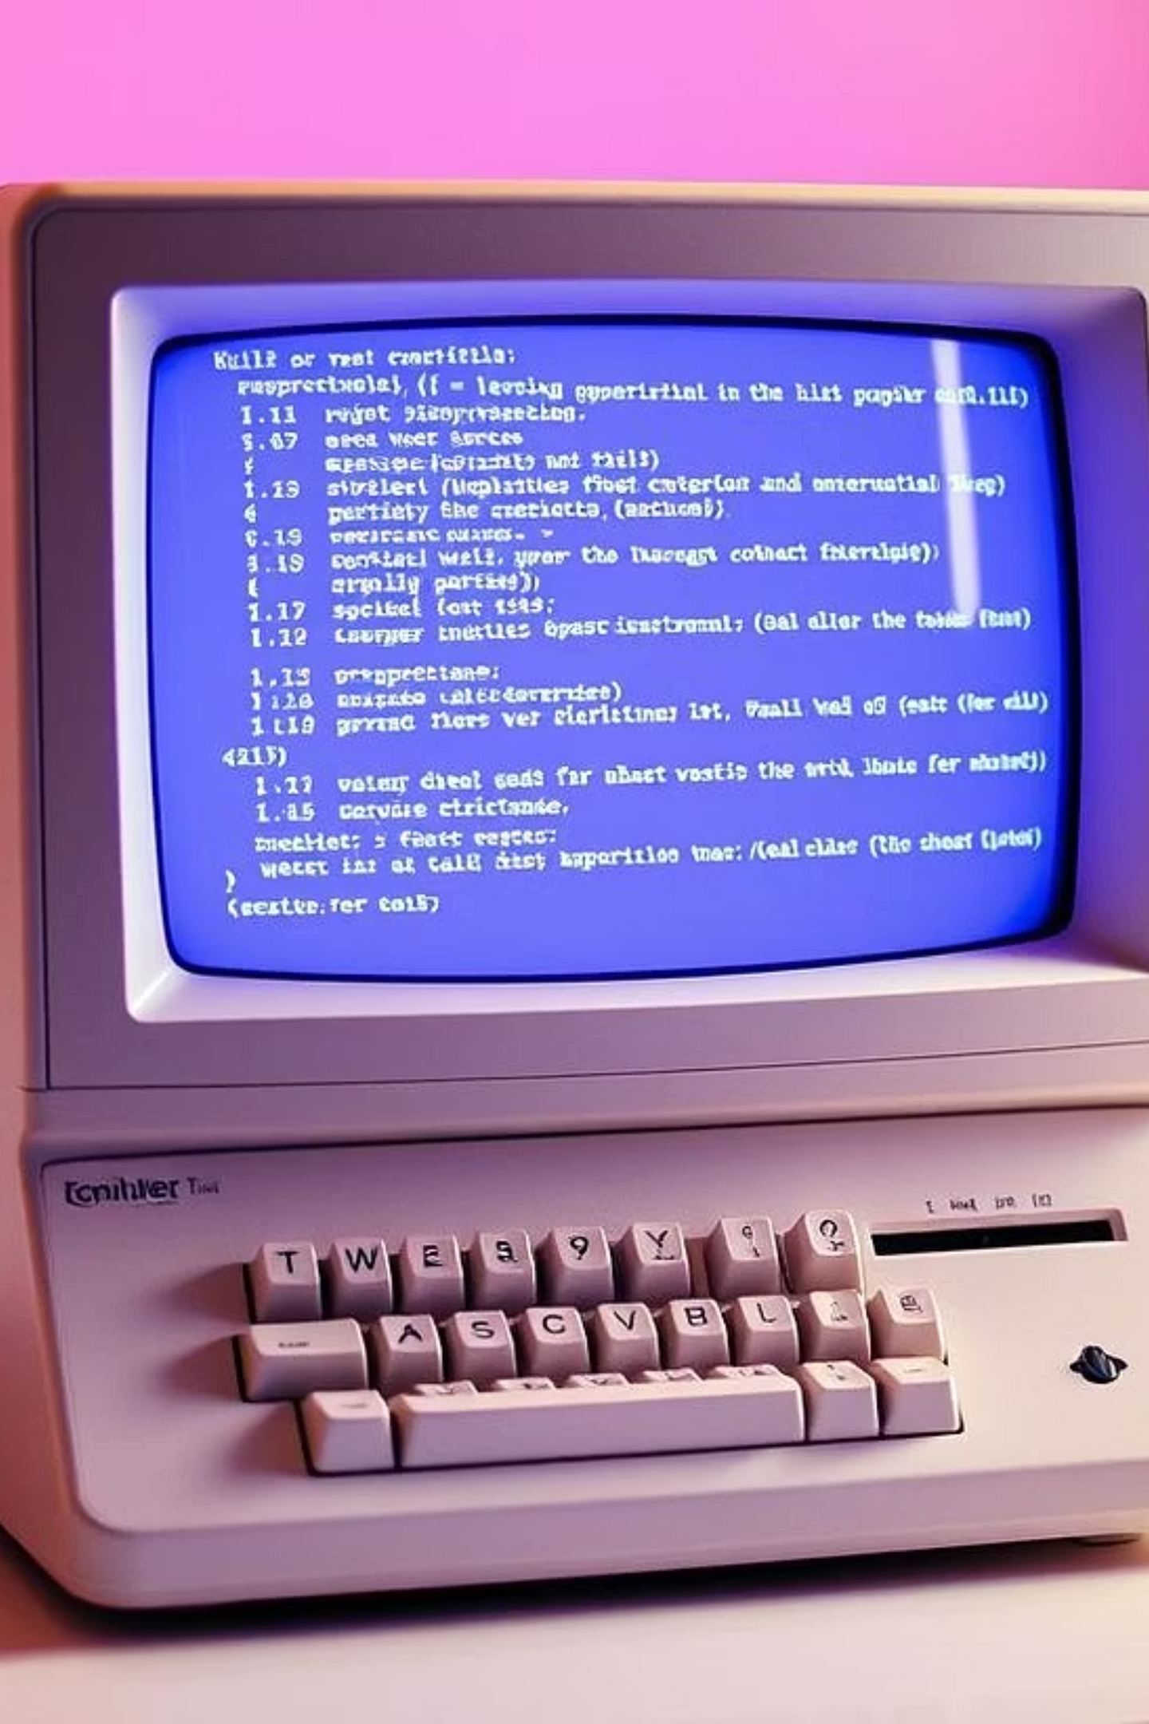
History of Linux
1
1970s
Unix developed at AT&T Bell Labs.
2
1991
Linux created by Linus Torvalds.
3
GNU GPL
Announced and licensed under GNU GPL.
4
Global Contributions
Evolved with worldwide developer input.

Slide 5



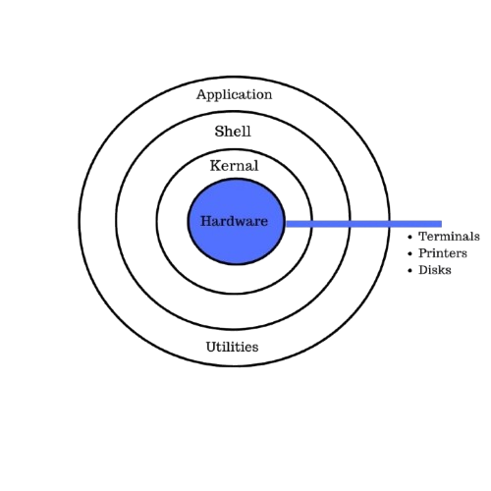


In-depth Linux Architecture
Hardware Layer
Kernel
System Libraries
The foundation of the system, comprising physical components like CPU, memory, storage, and I/O devices. The kernel interacts directly with this layer using specific device drivers.
The core of the Linux OS. It's a monolithic kernel, managing all fundamental services (process, memory, device, and file system management) directly in kernel space for optimal performance. It also provides system calls as an interface for user programs.
These libraries, like the GNU C Library (glibc), offer a crucial set of functions and APIs. They allow application programs to interact with the kernel indirectly, simplifying development by abstracting complex system calls.
System Utilities
Application Programs
A collection of small but powerful programs for various tasks. This includes essential tools (e.g., ls, cp, mv), administrative utilities (e.g., systemctl, cron), and command-line shells (e.g., bash, zsh) that facilitate system management.
End-user software that runs on top of the entire architecture. This includes a wide range of programs such as web browsers, text editors, and office suites, all relying on the underlying system libraries and utilities to function correctly.

Slide 6
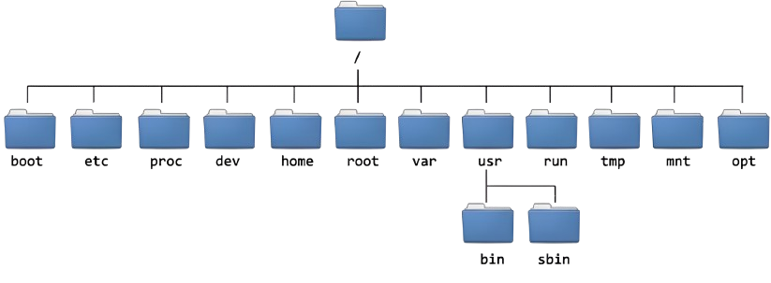
Linux Directory Structure

Slide 7
Linux Directory Structure
Directory
Description
/
Root directory – the top of the file system.
/bin
Essential command binaries (e.g., ls, cp).
/boot
Bootloader files, including Linux kernel.
/dev
Device files representing hardware.
/etc
System-wide configuration files.
/home
User home directories.
/usr User Utilities and Applications
/tmp Temporary Files

Slide 8
Linux Directory Structure
Directory
Description
/lib, /lib64
Shared libraries for programs.
/media
Mount point for removable media.
/mnt
Temporary mount point for manual mounts.
/opt
Optional third-party software.
/proc
Virtual FS with process/system info.
/root
Home directory of root user.
/run
Runtime variable data.
/srv Data for Services from System

Slide 9
Comparison with Other Operating Systems
Feature
Linux
Windows
macOS
Source Code
Open-source
Closed-source
Closed-source
Cost
Free
Paid
Paid
Customization
Highly customizable
Limited
Limited
Security
More secure
More vulnerable
Secure
Command Line
Powerful CLI
Optional CLI
Unix-based Terminal
Use Case
Servers, DevOps, Embedded
Personal, Gaming
Creative, Productivity

Slide 10
Conclusion
Powerful & Flexible
Ideal Use Cases
Strong Alternative
Offers better control, security, and performance.
Great for servers, development, and learning environments.
Provides a robust alternative to Windows and macOS.

